Slide 1

Chapter 2
Network Models
Copyright © The McGraw-Hill Companies, Inc. Permission required for reproduction or display.

Slide 2
A Network is ..
A combination of hardware (HW) and software (SW) that send data from one location to another.
HW: physical equipment that carries signals from one point of the network to another
SW: instruction sets that make possible the services that we expect from a network.
Data transformed into the form of electromagnetic signals when sent along a transmission medium (link).

Slide 3
2-1 LAYERED TASKS
Topics discussed in this section:
Sender, Receiver, and Carrier
Hierarchy

Slide 4
Network Architecture
General blue prints that guide the design and implementation of networks.
Examples:
OSI architecture
Internet architecture
Abstraction of the different services and procedures.
Abstraction naturally leads to layering.

Slide 5
Concept of Layers
We use the concept of layers in our daily life.
As an example, let us consider two friends who communicate through postal mail. The process of sending a letter to a friend would be complex if there were no services available from the post office.

Slide 6
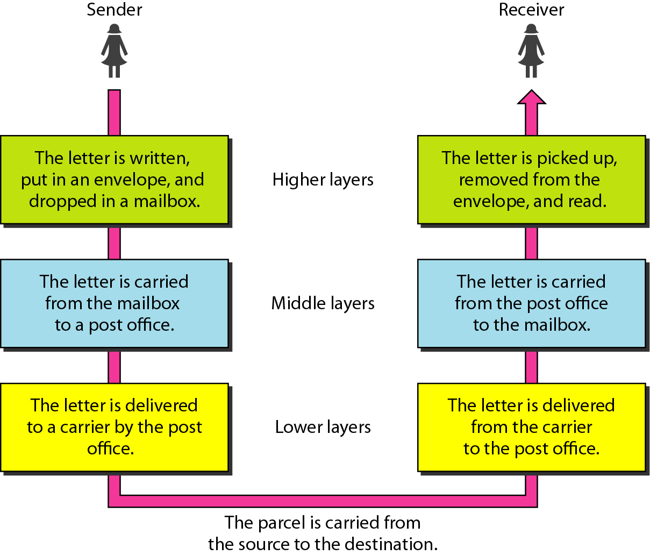
Figure 2.1 Tasks involved in sending a letter

Slide 7
Hierarchy
The tasks must be performed in the order specified by the hierarchy of the layers!

Slide 8
Concept of Layers
Each layer provides a specific set of services.
Services are provided through the definition of protocols.
Each layer uses the services provided by the lower/above layers.
Layers use protocols to communicate with each others.

Slide 9
Concept of Layers
Layering provides two nice features:
Decomposes the problem of building a network into more manageable components.
Provides a more modular design, modifying the functionality of the different layers without affecting the whole system!

Slide 10
2-2 THE OSI MODEL
Topics discussed in this section:
Layered Architecture
Peer-to-Peer Processes
Encapsulation

Slide 11
The OSI Model
An ISO standard that covers all aspects of network communications is the Open Systems Interconnection (OSI) model.
An open system is a set of protocol that allows any two different systems to communicate regardless of their underlying architecture (H/W and S/W).
ISO is the organization. OSI is the model.

Slide 12
The OSI Model
The OSI model is a layered framework for the design of network systems that allows for communication between all types of computer systems.
It consists of seven separate but related layers, each of which defines a part of the process of moving information across a network.

Slide 13
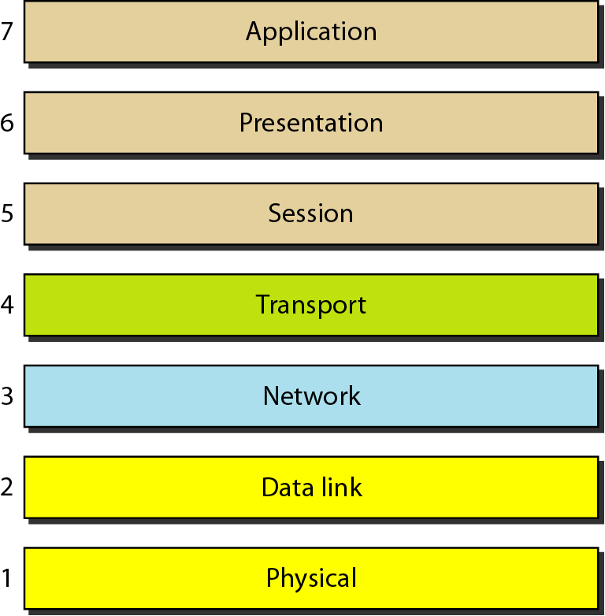
Figure 2.2 Seven layers of the OSI model

Slide 14
The ISO/OSI Reference Model
Source: Computer Networks, Andrew Tanenbaum
ISO: International Standards Organization
OSI: Open Systems Interconnection
Application
The protocol stack:
Presentation
The idea behind the model: Break up the design to make implementation simpler. Each layer has a well-defined function. Layers pass to one another only the information that is relevant at each level. Communication happens only between adjacent layers.
Session
Transport
Network
Data link
Physical

Slide 15
Layered Architecture
OSI model consists of 7 layers.
Each layer defines a family of functions distinct from those of the other layers.
Within a single machine, each layer calls upon the services of the layer just below it.
e.g. layer 3 uses the services provided by layer 2 and provides services for layer 4.

Slide 16
Layered Architecture
Between machines, layer x on one machine communicate with layer x on another machine.
This communication is govern by an agreed-upon series of rules and convention called protocols.
Communication between machines is a peer-to-peer process using the protocols appropriate to a given layer.

Slide 17
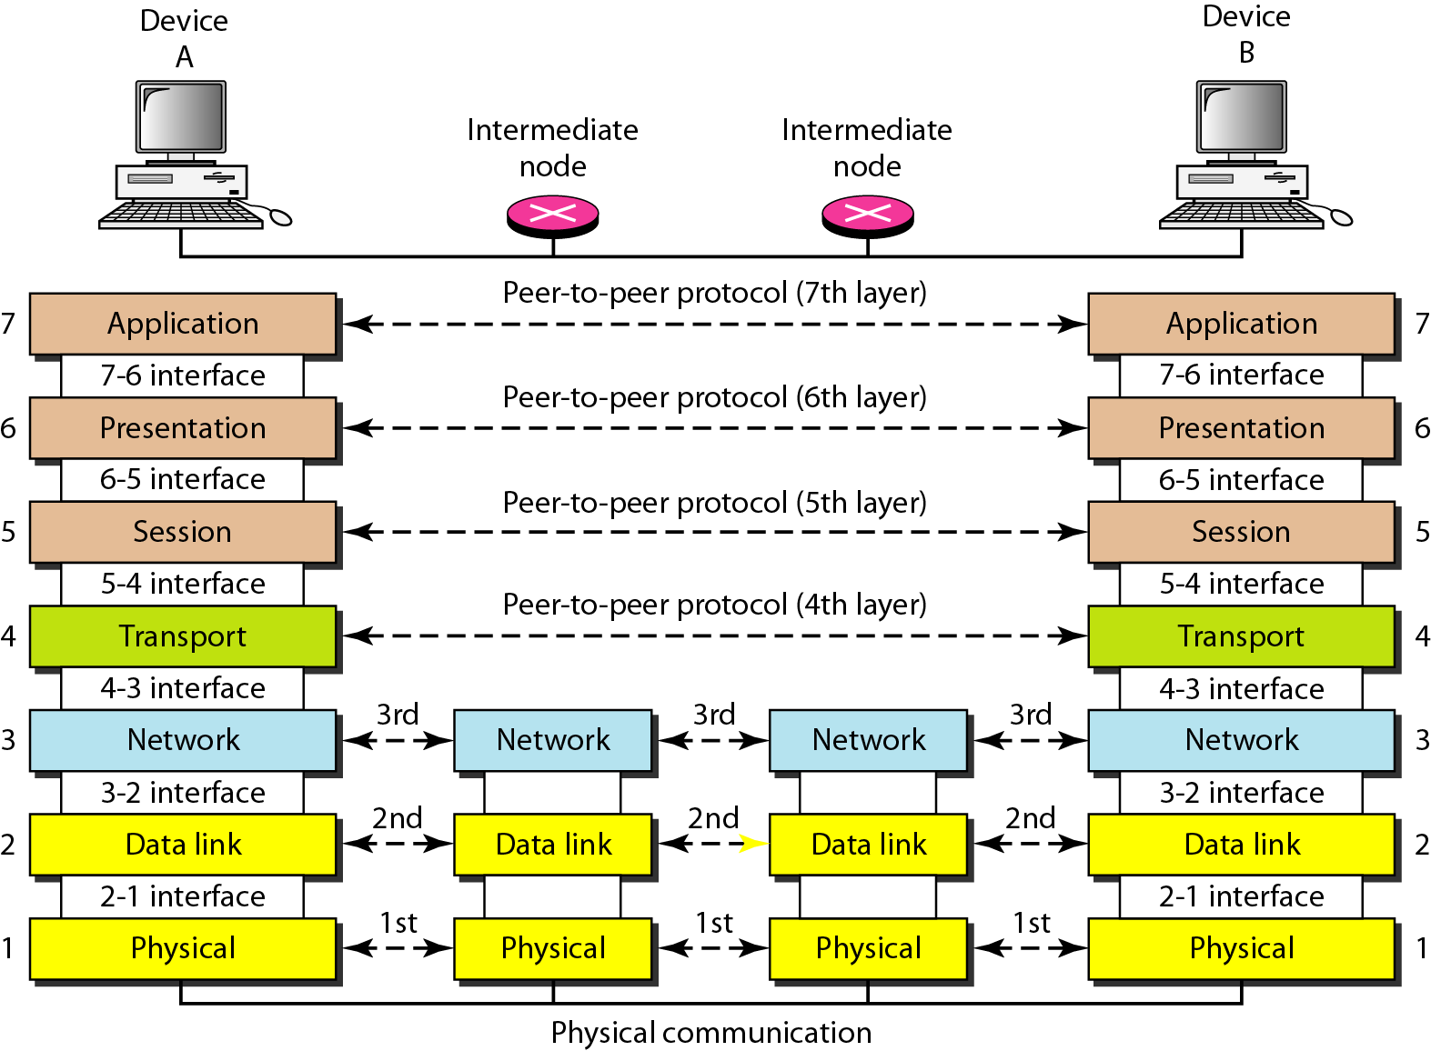
The interaction between layers in the OSI model

Slide 18
Peer-to-Peer Process
At the physical layer, communication is direct where device A sends a stream of bits to device B. The bits must be converted to a form that can be transmitted to the receiving device.
At the higher layers, communication must move down through the layers on device A over to device B and then back up through the layers.

Slide 19
Peer-to-Peer Process
Interfaces Between Layers
The passing of the data and network information down/up through the layers in sending/ receiving require an interface between each pair of adjacent layers.
Well-defined interfaces and layer functions provide modularity to a network.

Slide 20
Organization of the Layers
The seven layers can be thought of as belonging to three subgroups:
Layers 1,2, and 3 – physical, data link, and network – are the network support layers.
Layers 5,6, and 7 – session, presentation, and application – are user support layers; they allow interoperability among unrelated software systems.

Slide 21
Organization of the Layers
The seven layers can be thought of as belonging to three subgroups:
Layer 4, the transport layer, links the two groups and ensures that what the lower layers have transmitted is in a form that the upper layers can use.
The upper OSI layers almost implemented in S/W; lowers layers are combination of S/W and H/W except for the physical layer which is mostly H/W.

Slide 22
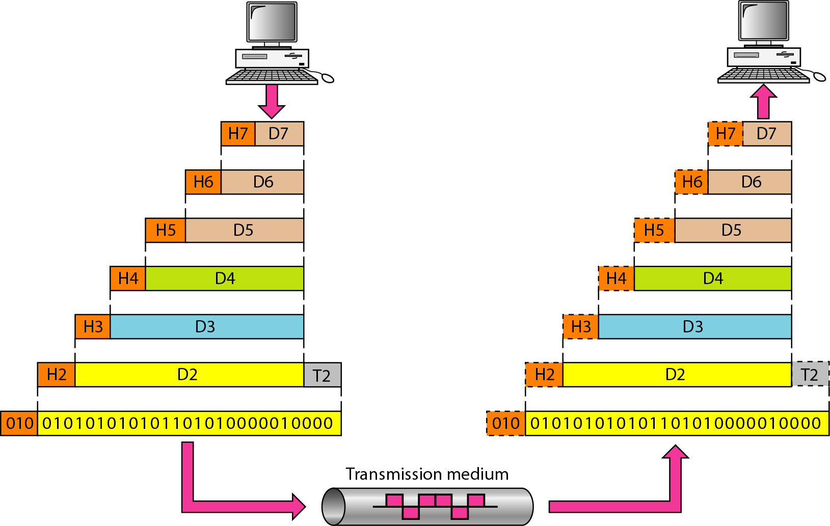
Figure 2.4 An exchange using the OSI model
Organization of the Layers

Slide 23
Encapsulation
Another aspect of data communications in the OSI model is encapsulation.
The data portion of a packet at level N-1 carries the whole packet (data and header and maybe trailer) from level N.
Level N-1 is not aware of which part of the encapsulated packet is data and which part is the header or trailer.
For level N-1, the whole packet coming from level N is treated as one logical unit.

Slide 24
2-3 LAYERS IN THE OSI MODEL
In this section we briefly describe the functions of each layer in the OSI model.
Topics discussed in this section:
Physical Layer Data Link Layer
Network Layer
Transport Layer
Session Layer
Presentation Layer
Application Layer

Slide 25
Physical layer
The physical layer coordinate the functions required to carry a bit stream over a physical medium including:
Dealing with the mechanical and electrical specifications of the interfaces and transmission medium.
It defines the procedures and functions that physical devices and interfaces have to perform for transmission to occur.

Slide 26
Physical layer
The physical layer is also concerned with:
Physical characteristics of interfaces and medium.
Representation of bits
Data rate
Synchronization of bits
Line configuration
Physical topology
Transmission mode

Slide 27
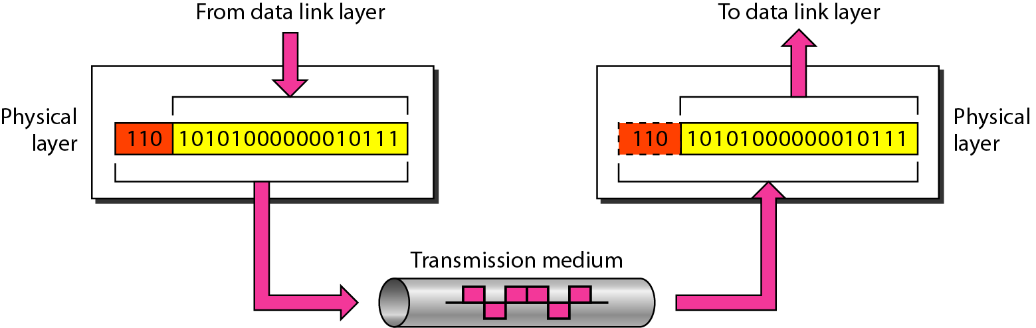
Figure 2.5 Physical layer

Slide 28
Data Link layer
The data link layer transforms the physical layer to reliable link.
It makes the physical layer appear error-free to the upper layer (network layer).

Slide 29
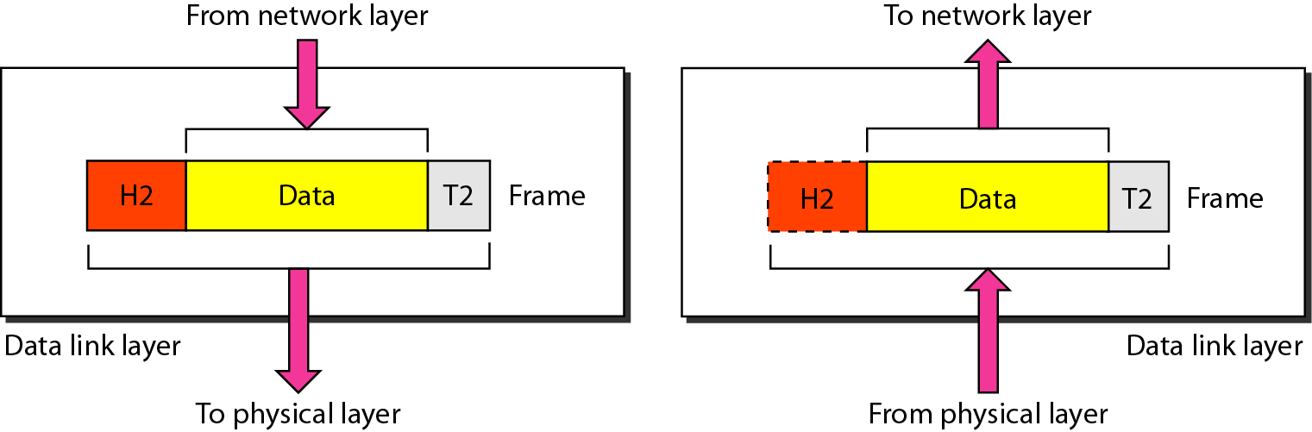
Figure 2.6 Data link layer

Slide 30
Data Link layer
The data link layer provides hop-to-hop delivery.

Slide 31
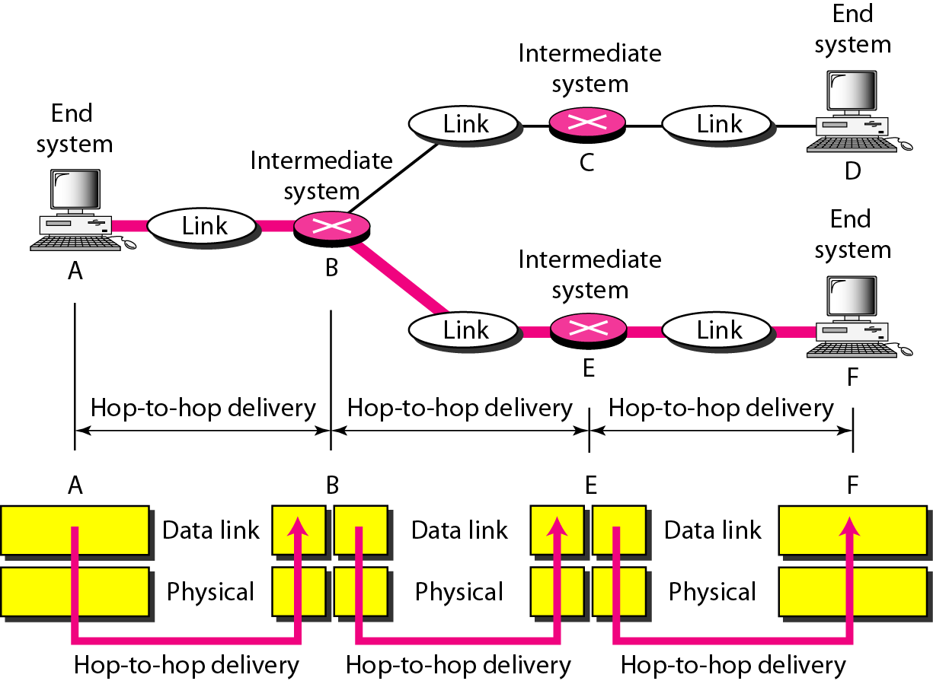
Figure 2.7 Hop-to-hop delivery

Slide 32
Data Link layer
There are other responsibilities of data link layer include:
Framing
Physical addressing
Flow control
Error control
Access control

Slide 33
Network layer
The network layer is responsible for the delivery of individual packets from the source host to the destination host.
At the sender side, data is received from the higher layer (transport) and passed down to the lower layer (data link).
At the receiver side, data is received from the lower layer (data link) and passed up to the upper layer (transport).

Slide 34
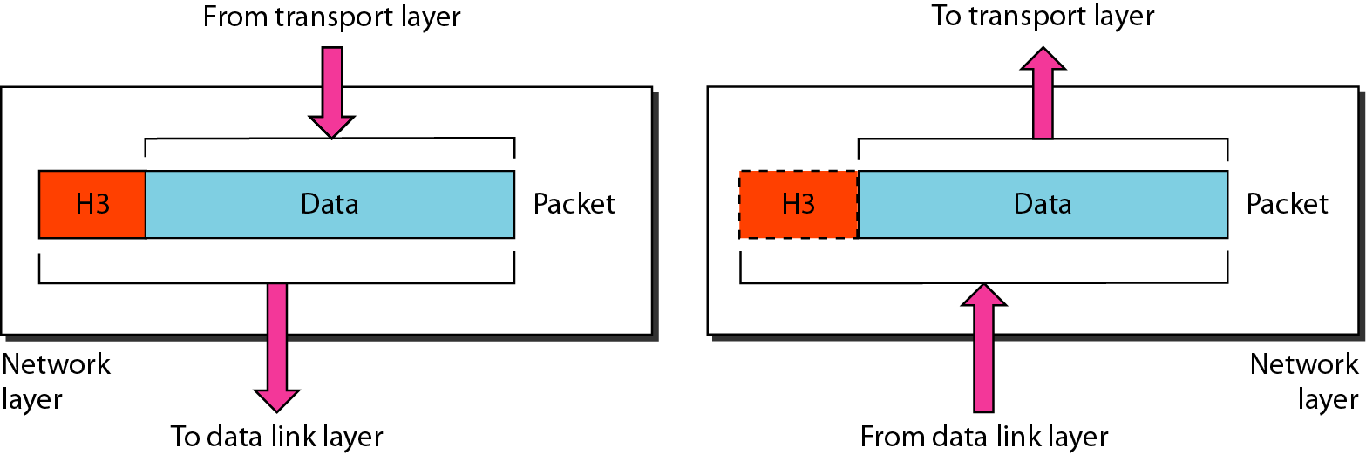
Figure 2.8 Network layer

Slide 35
Network layer
Again, the network layer is responsible for the delivery of individual packets from source to destination.
If two systems are connected to the same link, there is usually no need for a network layer.
If the two systems are attached to different networks with connecting devices between the networks, there is often a need for the network layer to accomplish source-to-destination delivery.

Slide 36
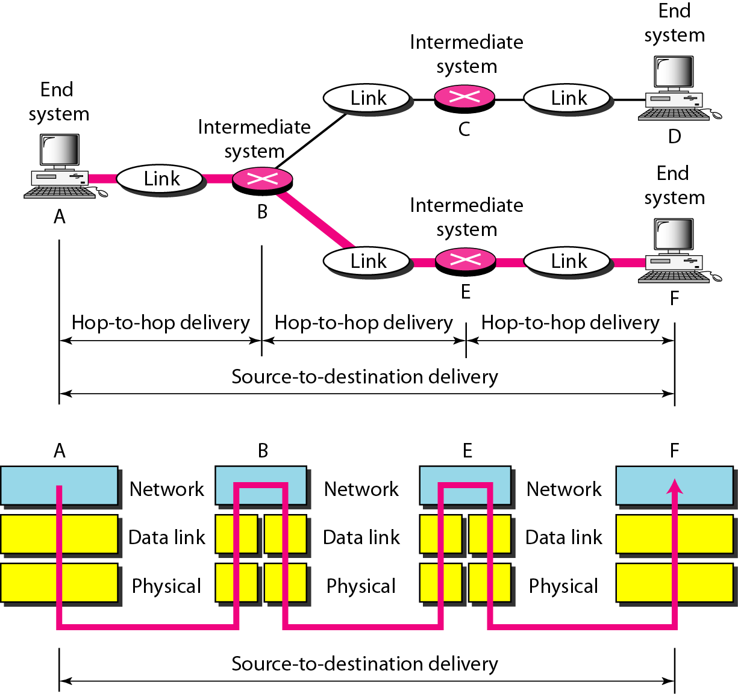
Figure 2.9 Source-to-destination delivery

Slide 37
Network layer
Other responsibilities of network layer include:
Logical addressing
Routing

Slide 38
Transport layer
The transport layer is responsible for the delivery of a message from one process to another.
At the sender side, it receives application data and passes it down to the network layer.
At the receiver side, it receives data from the network layer and passes it up to the appropriate process.

Slide 39
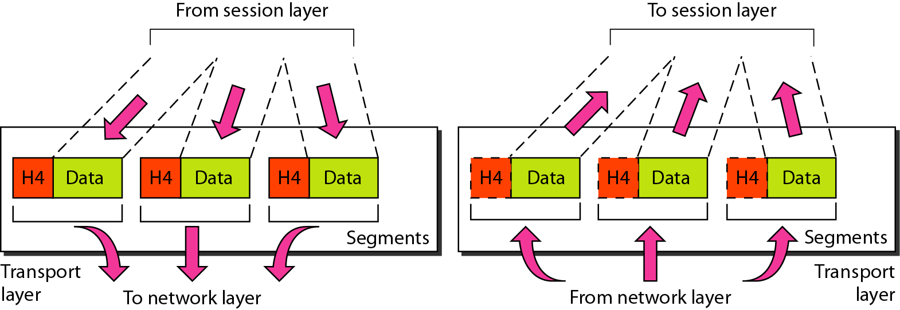
Figure 2.10 Transport layer

Slide 40
Transport layer
Again, the transport layer is responsible for the delivery of a message from one process to another.
Unlike the network layer which is source-to-destination delivery, the transport layer is process-to-process delivery of the entire message.

Slide 41
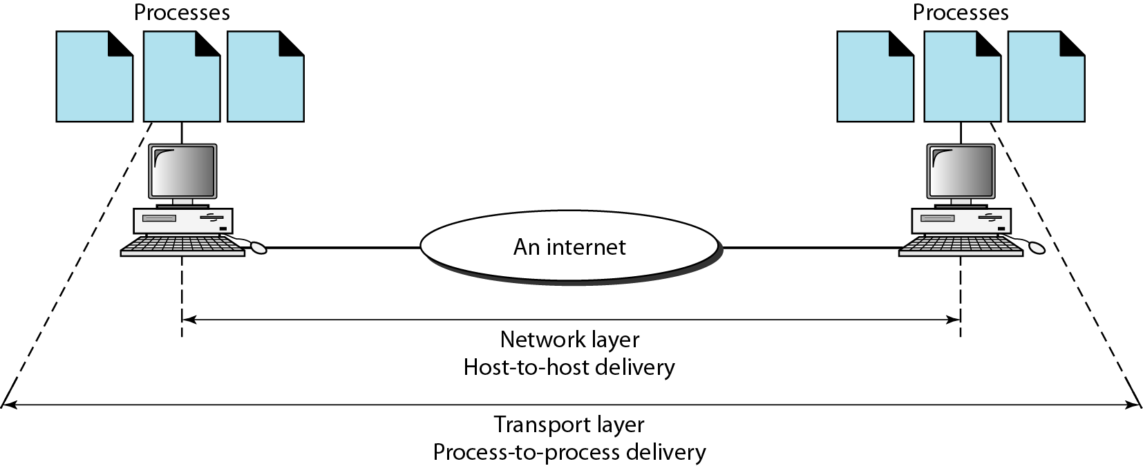
Figure 2.11 Reliable process-to-process delivery of a message

Slide 42
Transport layer
Other responsibilities of transport layer:
Service-point addressing
Segmentation and reassembly
Connection control
Flow control
Error control

Slide 43
Session layer
The session layer is responsible for dialog control and synchronization.

Slide 44
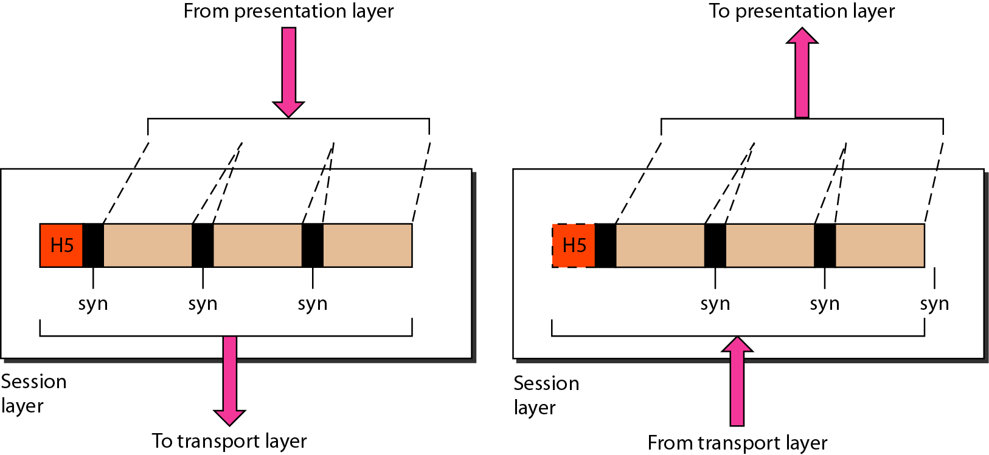
Figure 2.12 Session layer

Slide 45
Session layer
Specific responsibilities of the session layer include:
Dialog control
Synchronization

Slide 46
Presentation layer
The presentation layer is concerned with syntax and semantics of the information exchange between two systems.

Slide 47
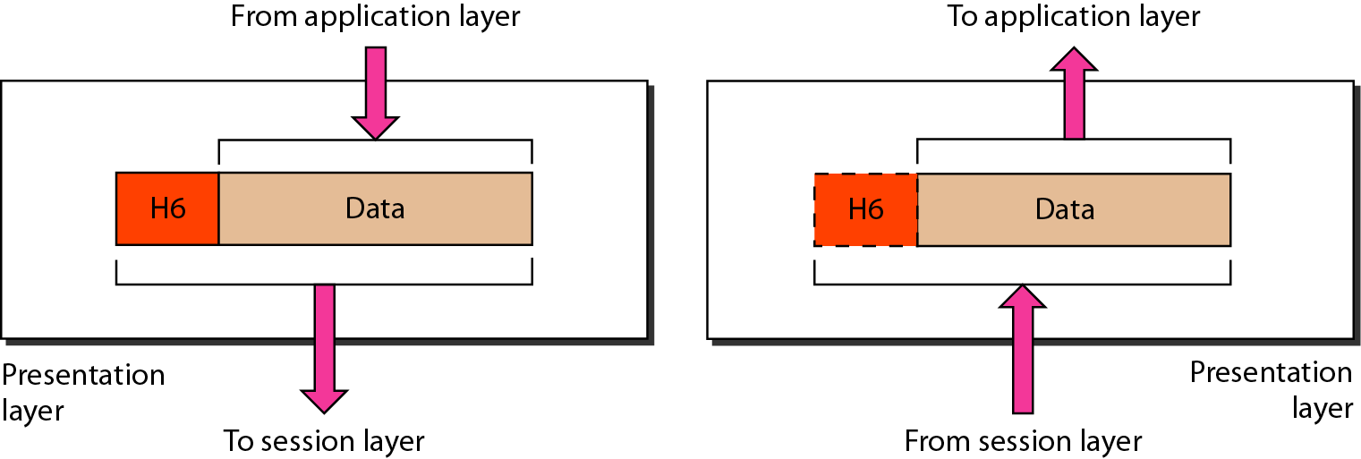
Figure 2.13 Presentation layer

Slide 48
Presentation layer
Specific responsibilities of presentation layer:
Translation
Encryption
Compression

Slide 49
Application layer
The application layer enables user, whether human or software, to access the network.
It provides user interfaces and support for services such as e-mail, remote file access and transfer, shared database management, and other types of distributed information services.

Slide 50
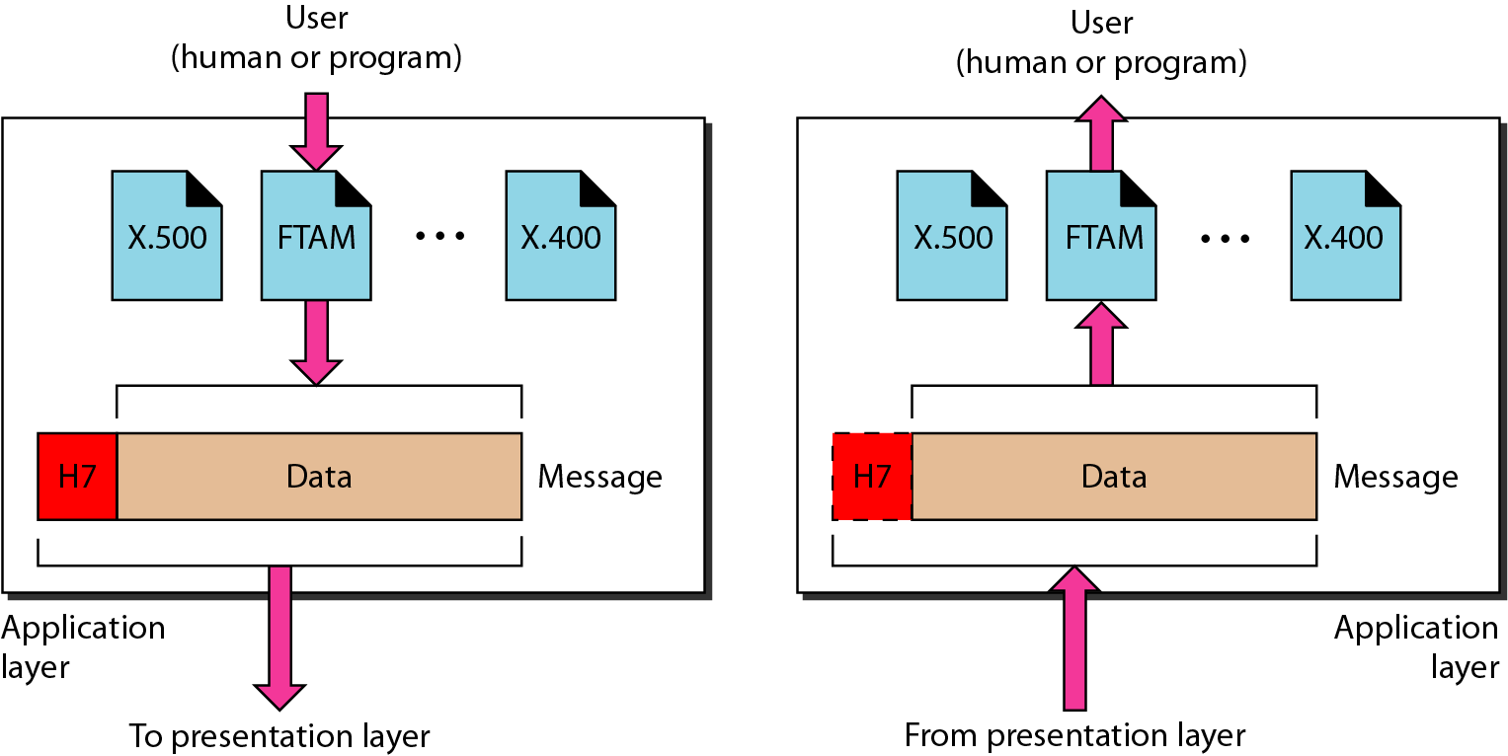
Figure 2.14 Application layer

Slide 51
Application layer
Specific responsibilities of presentation layer:
Network virtual terminal
File transfer, access, and management
Mail services
Directory services

Slide 52
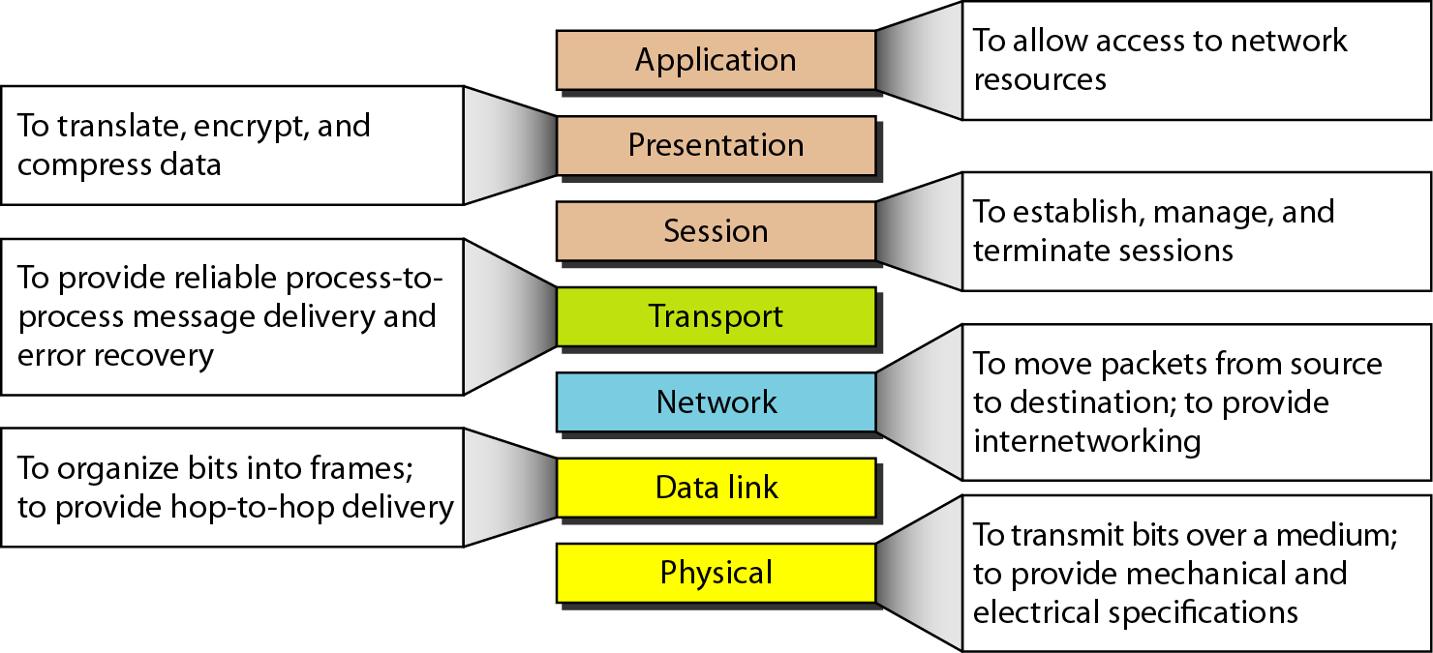
Figure 2.15 Summary of layers

Slide 53
2-4 TCP/IP PROTOCOL SUITE
The layers in the TCP/IP protocol suite do not exactly match those in the OSI model.
The original TCP/IP protocol suite was defined as having four layers: host-to-network, internet, transport, and application.
When TCP/IP is compared to OSI, we can say that the TCP/IP protocol suite is made of five layers: physical, data link, network, transport, and application.

Slide 54
The Layers in the TCP/IP Protocol Suite
Source: The TCP/IP Protocol Suite, Behrouz A. Forouzan
Application
FTP
HTTP
DNS
NFS
…
Presentation
Session
Transport
TCP
UDP
IP
ICMP
IGMP
Network
ARP
RARP
Data link
Physical
Figure 2.16 TCP/IP and OSI model

Slide 55
2-4 TCP/IP PROTOCOL SUITE
TCP/IP is a hierarchical protocol made up of interactive modules, each of which provides a specific functionality.
The layers of the TCP/IP protocol suite contain relatively independent protocols.
The term hierarchical means that each upper-level protocol is supported by one or more lower-level protocols.

Slide 56
2-4 TCP/IP PROTOCOL SUITE
Physical and Data Link Layers
No specific protocol is defined at this layer, rather, TCP/IP model supports all the standard and proprietary protocols.
For instance, a network in a TCP/IP internetwork can be a local-area network or a wide-area network.

Slide 57
2-4 TCP/IP PROTOCOL SUITE
Network layer (internetwork layer)
TCP/IP at this layer supports the Internetworking Protocol (IP)
There are also some other protocols that support data movement in this layer. Including: ARP, RARP, ICMP, and IGMP.

Slide 58
Protocols at The Network Layer
Internetworking Protocol (IP)
Most important protocol of the TCP/IP network stack!
Implements internetworking.
IP is an unreliable and connectionless protocol- a best-effort delivery.
It is host-to-host protocol.

Slide 59
Protocols at The Network Layer
Address Resolution Protocol (ARP)
It is used to find the physical address (NIC) of the node after its Network address is known.
Reverse Address Resolution Protocol (RARP)
It is used to find the Internet address of the node after its physical address is known.

Slide 60
Protocols at The Network Layer
Internet Control Message Protocol (ICMP)
It is used by hosts and gateways to send notification of datagrams ( packets) problem back to the sender.
Internet Group Message Protocol (IGMP)
It is used to facilitate the simultaneous transmission of messages to a group of recipients.

Slide 61
2-4 TCP/IP PROTOCOL SUITE
Transport Layer
In this layer, the protocol is responsible for delivery of message from a process to another process.

Slide 62
Protocols at The Transport Layer
User Datagram Protocol (UDP)
It adds port addresses, checksum error control, and length information to the data from the upper layer.
Transmission Control Protocol (TCP)
It is reliable and connection-oriented.

Slide 63
Protocols at The Transport Layer
Stream Control Transmission Protocol (STCP)
It supports the newer application e.g. voice over the Internet.
It combine best features of UDP and TCP.

Slide 64
2-4 TCP/IP PROTOCOL SUITE
Application Layer
The application layer in TCP/IP is equivalent to the combined session, presentation, and application.

